Slide 1

BLOCKCHAIN TECHNOLOGY
The Future of Decentralized Systems

Slide 2
INTRODUCTION
U . V PATEL COLLEGE OF ENGINEERING
Subject: seminar
Topic : Blockchain Technology
Prepared by : keshar upadhyay
Branch : Computer Engineering ,B-3
Enrollment number : T24012011073

Slide 3


Slide 4
What is Blockchain Technology?
A Blockchain is a destibuted Database or ledger That is shared among the computer network . As a database blockchain store the data in a electronically in digital format . Blockchain are best known for their crucial role in a cryptocurrency , such as a Bitcoin for maintaining a secure and a dentralized record for a transactions.The innovation with a blockchain is that it guarantee a feadility and security of a recorded data and generate a trust without a need of a trusted third party .

Slide 5
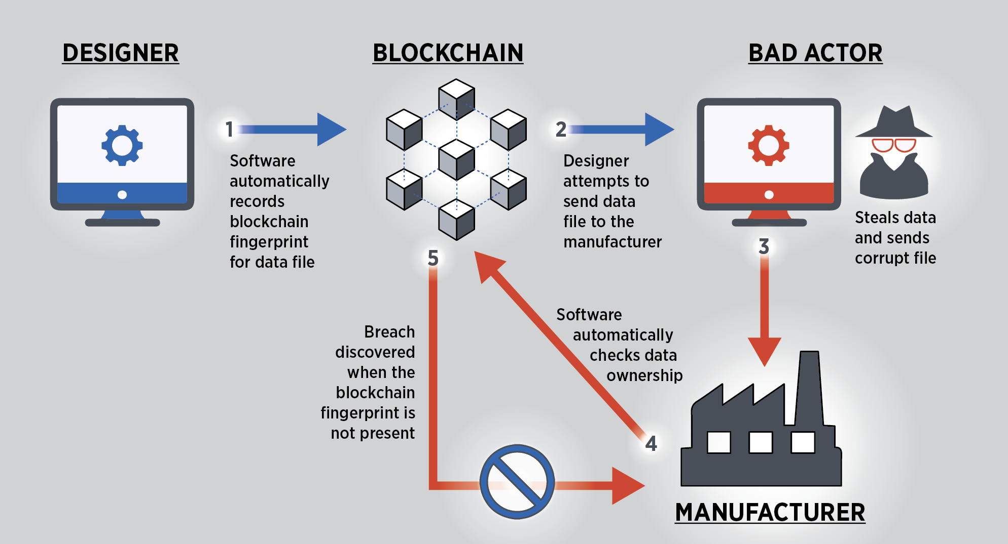

Slide 6
Fundamental of a Blockchain Technology
1 public distibuted ledgers
A blockchain is a decentralized public distrubuted ledgers that is used to record transition across many computer
A distibuted ledgers is a database that is shared among the users of the blockchain network
2 Encryption
Blockchain eliminate unauthorized access by using a cryptographics algorithm to ensure the block are kept secure
Each users in the blockchain has their key

Slide 7
3 proof of work
Proof of work (POW) is a method to validate a transitions in a blockchain network by solving a complex mathematical problem called a mining.
4 Mining
In blockchain when a miners uses their resources (time , money , electricity ,etc…)to validate a transition and record them on the public ledhers, they are given a reward .
Note as a reward miners get 12.5 BTS (Bitcoin)

Slide 8
Four Types of Blockchain Technology
1 public Blockchain
These blockchain is completely open to following the idea of a decentalization. They don’t have any restriction, anyone having a computer and network can participate
2 Private Blockchain
These blockchain is not decentralized as a public blockchain only selected nodes can participate in the process, making it more secure than the others .
3 Consortium Blockchain
It is the creative approch of solving the problem of organization. This blockchain validates the transition and also initates and receives transition. It is also known as a federated Blockchain.
4 Hybrid Blockchain
It is the mixed content of a public and a private blockchain , where some parts are controlled by a some organizaton and others makes are visible as a pulic blockchain .

Slide 9
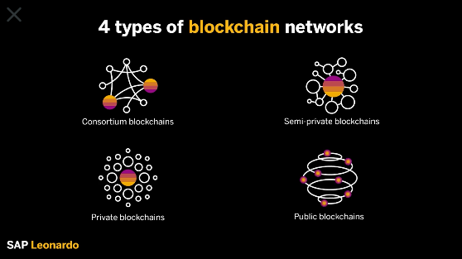

Slide 10
Why is Blockchain Important ?
Blockchain is an especially promising and revolutionary technology because it helps reduce security risk, stamps out fraud and bring transparency in a scalable way . originally popularized in the 2010s by its association with the cryptocurrency and NFTs, blockchain technology has since evolved to became a management solution for all the types of the global industries . Today you can find Blockchain technology providng transparency for the food supply chain , securing helathcare data, innovating gaming and overall changing how we handle data and ownership on a large scale .

Slide 11
How Does Blockchain Work ?
The great of blockchain is to allow digital information to be recorded and distributed . But not edited . In this way a blockchain is the foundation for immutable leadgers , or record of a transactions that cannot be altered , deleted , or destroyed . This is why blockchain are also known as a distributed ledgers technology (DLT).
First propsed as a research project in 1991, the blockchain concept predated its first widsepered application in use : Bitcoin ,in 2009 .in th years since , the use of blockchain has exploded via the creation of various cryptocurrencies, decentralized finance (DeFI) application , non fungible tokens (NFTS) and smart contract.

Slide 12
Decentralization in a Blockchain
In the blockchain , decentralization alludes to the transfer f supervision and decision making form a centralized association ( individual , corporation , or , group of a people ) to a dispered network . Decentralized network endeavor to decrease the degree of trust that members should put in each others and dissuade their capacity to put forth authority or command over others in manners that corrupt the potency of the network .

Slide 13
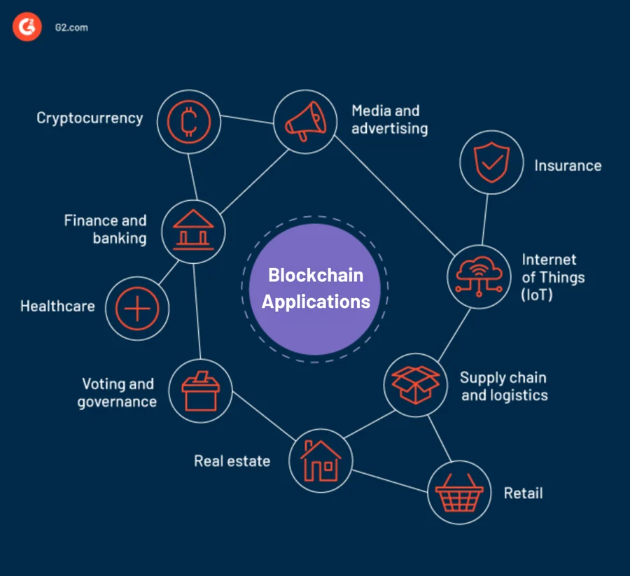

Slide 14
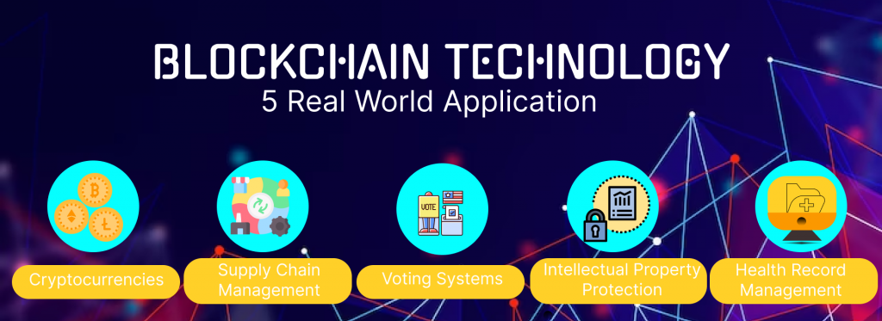

Slide 15
Bitcoin vs Blockchain
The Bitcoin protocol is built on a blockchain . In a research paper introducing the digital currency , bitcoin’s pseudonymous creator , satoshi Nakamoto , referred to it as “ a new electronic cash system that’s fully peer to peer , with no trusted third party “
Blockchain technology was first outlined in 1991 stuart haber and w.scott stornetta , two researcher who wanted to implement system where document timestamps could not be tampered with. But it wasn’t until almost two decades later , with the launch of bitcoin in january 2009 , that blockchain had its first real world application

Slide 16


Slide 17
Advatages of Blockchain
1 Open : one of the major advantages of blockchain technology Is that it is accessible to all means anyone can becomes a participants in the contibution to blockchain technolgy
2 Verifiable : Blockchain technology is used to store information in a decentralized manners so everyone can verify the correctness of the information by using zero knowledge .
3 Permanent : record or information which is stored using blockchain technology is permanent means one need not worry about losing the data .
4 Tighter Security : Blockchain uses hashing techniques to stores each transcition on a block that is connected to each others so it has tighter security .
5 Efficiency : Blockchain removes any thrd party intervention between transcition and remove the system efficient and faster . Settlement is made easier and smooth.
6 Cost Reduction : As blockchain needs no third man it reduces the cost for the businesses and gives trust to the other partner

Slide 18
Disadvantages of Blockchain
1 scalability : it is one of the biggest drawbacks of blockchain technology as it cannot be scaled due to fixed size of the block of storing information .
2 Energy Consuming : for verifying any transition a lot of energy is used so it becomes a problem according to the survey it is considered that 0.3 perecent of the world’s electricity had been used by 2018 in the verification og transicition done using blockchain technology .
3 Time consuming : To add the next block in the chain miners need to compute nonce values many times so this is a time consuming process and needs to be speed up to be used for a industrial purpose .
4 Legal Formalities : in some countries , the uses of blockchain technology application is banned like the cryptocuurency due to some environmental issues .
5 storages : Blockchain databases are stored on all the nodes of the network creates as issue with the storage , increasing numbers of transactions will require more storage.

Slide 19
conclusion
The bitcoin is the first successful implementation of blockchain . Today , the world has found application of blockchain technology in several industries , where the trust without the involvement of a centralize authority is desired . so welcome to the world of blockchain .
Blockchain technology is only going to grow in the field of business , finance , law, medicine , and real estate . Whether you’re an experienced Blockchain developer , or you’re aspiring to break into the exciting industry , enrolling in our blockchain certification Training program will help individual with all levels of experience to learn Blockchain developer techniques and strategies .

Slide 20


